Slide 1

Human Centered Design towards blockchain enabled platform for AmritaSREE Self Help Groups
Team Number: 36
Project Guide: Ms. Sruthy Anand
AM.EN.U4AIE20137 Kalla Likhit Sai Eswar
AM.EN.U4AIE20155 Pappala Kumar Aditya
AM.EN.U4AIE20171 Vuppala Naga Sushanth Kumar
Amrita School of Computing | Amrita Vishwa Vidyapeetham | Amritapuri

Slide 2
Introduction
Rural development is a critical need in developing countries, and many women's self-help groups have emerged worldwide to create livelihood opportunities for women.
AmritaSREE, initiated by Sri Mata Amritanandamayi Devi, which stands for "Amrita Self Reliance Education and Employment,"
It a network Self-Help Groups aimed at empowering unemployed and economically vulnerable women by providing them with financial support.
Using mobile computing and a human-centered design approach, the project proposes a unique solution for addressing the challenges of the community.
The client-server approach can be operated as the framework for the mobile application with the help of the networking framework.
The proposed solution incorporates blockchain technology to ensure transparency, trust, and accountability among users, with the use of consensus algorithms and smart contracts to enhance transparency within the organization.

Slide 3
Motivation
The current record-keeping methods employed by AmritaSREE self-help groups rely on manual processes like physical ledgers, which are prone to errors and lack transparency.
With the proposed solution, imagine a scenario where group members have access to a dedicated mobile app developed to their needs.
Through this app, SHG’s can securely document and manage their financial transactions digitally.
Suppose a group member needs to perform a financial transaction, like borrowing money from the group's fund. Through the mobile app, she can easily initiate the transaction, which will be recorded and authenticated on the blockchain ledger. This system promotes accountability and safeguards against unauthorized or fraudulent activities within the group.

Slide 4
Background Study/Related Work
Title &year | Problem | Contributions | Limitations | Open problems/Future work
Empowerment of Women Self Help Groups: Human Centered Design of a Participatory IoT solution. 2020 | Empowering women through SHG organizations requires better communication, resource management, and financial control than current methods like manual ledgers, phone networks, or WhatsApp groups provide. | The paper proposed an architecture and designed a Mobile Application to improve the life of this rural women. The focus of this paper is on discussing the factors that need to be considered for designing a human centered UI services for a target audience | The study might not fully address the various human factors that could impact the successful adoption and empowerment of women self-help groups. The paper does not discuss the technicality of the financial operations involved in the organization. | Significant UI design and user functionalities to ensure user adoption to the mobile application. Character recognition due with image processing functions. Explore various applications of natural language processing for mobile application.

Slide 5
Background Study/Related Work
Title &year | Problem | Contributions | Limitations | Open problems/Future work
Consensus Agreement for Secure Transactions in Self Help Groups 2021 | Inefficiency, lack of transparency, and potential errors associated with the current paper-based ledger system used by the self-help group "AmritaSREE" in rural India for recording financial transactions and loans. | Introduces the use of consensus algorithms and smart contracts to enhance financial transaction transparency and security. Proposes the Byzantine Fault Tolerance algorithm for consensus. Human-centered design principles based on considering regional language and user characteristics such as age, gender, literacy, and technology proficiency, for better acceptance and adoption in rural areas. | The need for community acceptance and understanding of digital ledger maintenance over physical ledgers, which may be hindered by varying user age groups and their technological capabilities. | Design and implementation of the proposed blockchain based consensus agreement and smart contracts Explore the scalability and efficiency of the consensus mechanism in handling a larger volume of transactions.

Slide 6
Background Study/Related Work
Title &year | Problem | Contributions | Limitations | Open problems/Future work
Blockchain, adoption, and financial inclusion in India: Research opportunities 2020 | Understanding user behavior and fostering acceptance of blockchain-based financial services in digital landscape. In India, where the digital divide poses a significant challenge, meeting the diverse needs of users is paramount to ensure financial inclusion. | The novel part of the paper lies in its exploration of blockchain technology's potential for promoting financial inclusion in India. By focusing on financial inclusion and addressing specific research opportunities in India, the paper contributes valuable knowledge to the blockchain literature and offers practical insights for policymakers and industry stakeholders. | While the paper identifies research opportunities, it does not delve deeply into the practical challenges of implementing blockchain solutions in the Indian financial system. The research does not rely on a limited perspective, potentially impacting the findings and limiting the representation of diverse perspectives. | Technology adoption in emerging markets such as rural India can be more researched. Research to identify unique opportunities and challenges for adopting blockchain and user behavior to technological infrastructure.

Slide 7
Background Study/Related Work
Title &year | Problem | Contributions | Limitations | Open problems/Future work
A survey of breakthrough in blockchain technology: Adoptions, applications, challenges and future research. 2023 | Challenges in the adoption and implementation of blockchain technology, despite its significant potential benefits across various industries. The study highlights the need to address these challenges to fully realize the potential of blockchain technology in applications beyond cryptocurrencies, including finance, healthcare, supply chain, insurance, and the internet of things. | Comprehensive overview of blockchain technology and its applications beyond cryptocurrencies, highlighting its transformative potential in various sectors. Insights into recent developments, adoptions, and challenges, addressing key issues in security, privacy, scalability, and more. | Doesn't delve deeply into specific technical details in the case studies. | Continued research and development efforts to address the existing and upcoming challenges in blockchain technology As blockchain adoption continues to grow, a need for comprehensive regulatory frameworks that can ensure both security and compliance in various industries.

Slide 8
Background Study/Related Work
Title &year | Problem | Contributions | Limitations | Open problems/Future work
Key principles for user-centred systems design 2010 | The problem discussed in paper is research that typically revolves around the challenges of creating technology systems and interfaces that prioritize user needs, preferences, and usability. These challenges often include issues related to user interface design, user behavior analysis, accessibility. | The paper identifies and presents key principles for user-centered systems design. how these principles can be effectively integrated into the design and development process of IOT systems. It provides valuable insights into usability testing, user feedback collection, and iterative design processes. main aim of our definition and key principles is to support the development process. | The principles outlined may not be universally applicable, and their effectiveness might vary depending on the nature of the system or project. The field of user-centered design is continually evolving and changes in user behavior. The paper's principles and recommendations have become outdated over time | The field of user-centered design is continually evolving and changes in user behavior. The paper's principles and recommendations have become outdated over time thus the other aspects of the design based on requirement engineering can be researched.

Slide 9
Persisting Challenges
Designing a user-friendly interface for rural women, who may not be familiar with smartphones and apps, is vital.
Addressing the diversity of languages and cultures within rural communities is a challenge. To engagement, the app's content and user interface must be available in local languages of target audience.
Integrating mobile applications with blockchain technology presents another significant challenge. Finding ways and methods to achieve this integration is crucial for the app's success.

Slide 10
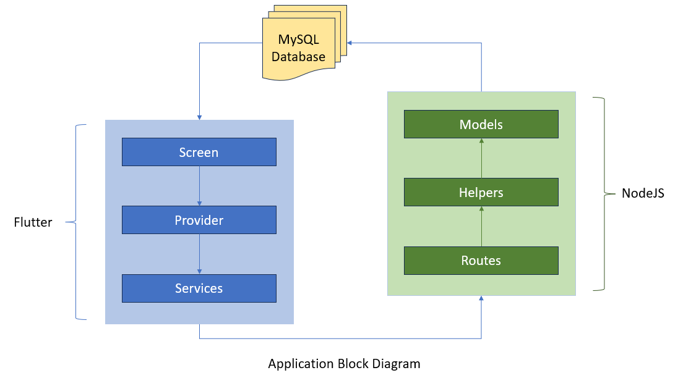
High Level Design
The following block diagram includes the technical functioning of the app based on the requests sent by the user between server and client.

Slide 11
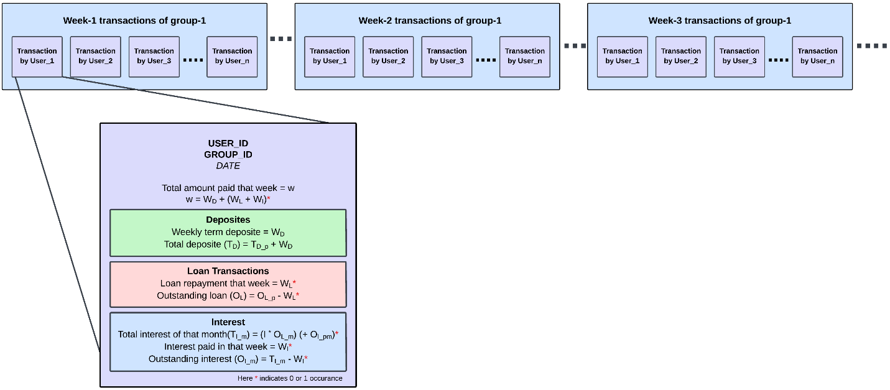
High Level Design
The following is the group-level block structure for the Proposed Blockchain-based AmritaSREE ledger.

Slide 12
Project Contributions
The project proposes the development of mobile computing for self-help groups (SHGs).
By developing a user-friendly mobile application, the project aims to provide them with a digital platform to manage their finances, and SHG operations efficiently.
Introducing blockchain technology to ensure transparency and trust among SHG members.
Through the use of blockchain based smart contracts and consensus algorithms, financial transactions are securely recorded and validated, reducing the chances of errors and enhancing accountability.

Slide 13
Project Contributions
What are the study objectives?
Ensuring the affordability and accessibility of mobile application infrastructure and services for SHG users.
Feasibility analysis for Blockchain Enabled Ledger Maintenance Requirement for Rural Self-Help Groups.
Comprehensive study of Blockchain Technology and consensus algorithms.
What are the outcomes?
Login & User Registration (including Two Factor Authentication) module of the SHG users.
Conceptual design of blockchain technology to be integrate with the AmritaSREE system.

Slide 14
Current status
Design of level-1 database for the Mobile application based on the requirements for current modules.
Implementation of Login and Registration Module of the mobile application is complete.
Our research work titled as “Examining Blockchain Enabled Ledger Maintenance Requirement for Rural Self-Help Groups” on blockchain based design for our system has been accepted at IEEE R10 HTC 2023 Conference.
Another paper that includes development details of the mobile application will be mostly likely to be submitted to a conference at the earliest.
Implementation of two factor authentication for login and self-registration is in process.

Slide 15
References
Sreeraj, S. S., et al. "Empowerment of women self-help groups: human centered design of a participatory iot solution." 2020 IEEE Global Humanitarian Technology Conference (GHTC). IEEE, 2020.
KA, Adithya Narayan, et al. "Consensus agreement for secure transactions in self-help groups." 2021 12th International Conference on Computing Communication and Networking Technologies (ICCCNT). IEEE, 2021.
Schuetz, Sebastian, and Viswanath Venkatesh. "Blockchain, adoption, and financial inclusion in India: Research opportunities." International journal of information management 52 (2020): 101936.
Sanka, A.I., Irfan, M., Huang, I. and Cheung, R.C., 2021. A survey of breakthrough in blockchain technology: Adoptions, applications, challenges and future research. Computer communications, 169, pp.179-201.
Jan Gulliksen , Bengt Göransson , Inger Boivie , Stefan Blomkvist , Jenny Persson & Åsa Cajander (2003) Key principles for user-centred systems design , Behaviour & Information Technology, 22:6, 397-409, DOI: 10.1080/01449290310001624329

Slide 16
Thank You

